Slide 1
Applied Data Science 2
Dr Ashley SpindLer
Semester A, 2022

Slide 2
Lecture 7 - Outcomes
Understand why and how we can pre-process data for machine learning
Get to grips with image pre-processing pipelines in TensorFlow
Understand the design and function of an “autoencoder”

Slide 3
Pre-Processing

Slide 4
Data Preprocessing
A vital step in any machine learning task is in ensuring the best quality and appropriate format of the data to be trained and tested

Slide 5
Preprocessing Tasks
For Non-image data:
Cleaning out NULL or NaN data
Standardising features
Handling categorical data
Encoding text data

Slide 6
Preprocessing Tasks
For Non-image data:
Cleaning out NULL or NaN data
Standardising features
Handling categorical data
Encoding text data
For Image Data:
Resizing and cropping
Converting the colour space
Standardising pixel values
Image “Augmentation”

Slide 7
Preprocessing Tasks
For Non-image data:
Cleaning out NULL or NaN data
Standardising features
Handling categorical data
Encoding text data
For Image Data:
Resizing and cropping
Converting the colour space
Standardising pixel values
Image “Augmentation”

Slide 8
Standardisation

Slide 9
Standardisation
Ensuring all images are the same size—convolutional neural networks need images to have the same height and width

Slide 10
Standardisation
Ensuring all images are the same size—convolutional neural networks need images to have the same height and width
Creating limits of the scales and orientations of objects in the images—based on what you expect the network might see

Slide 11
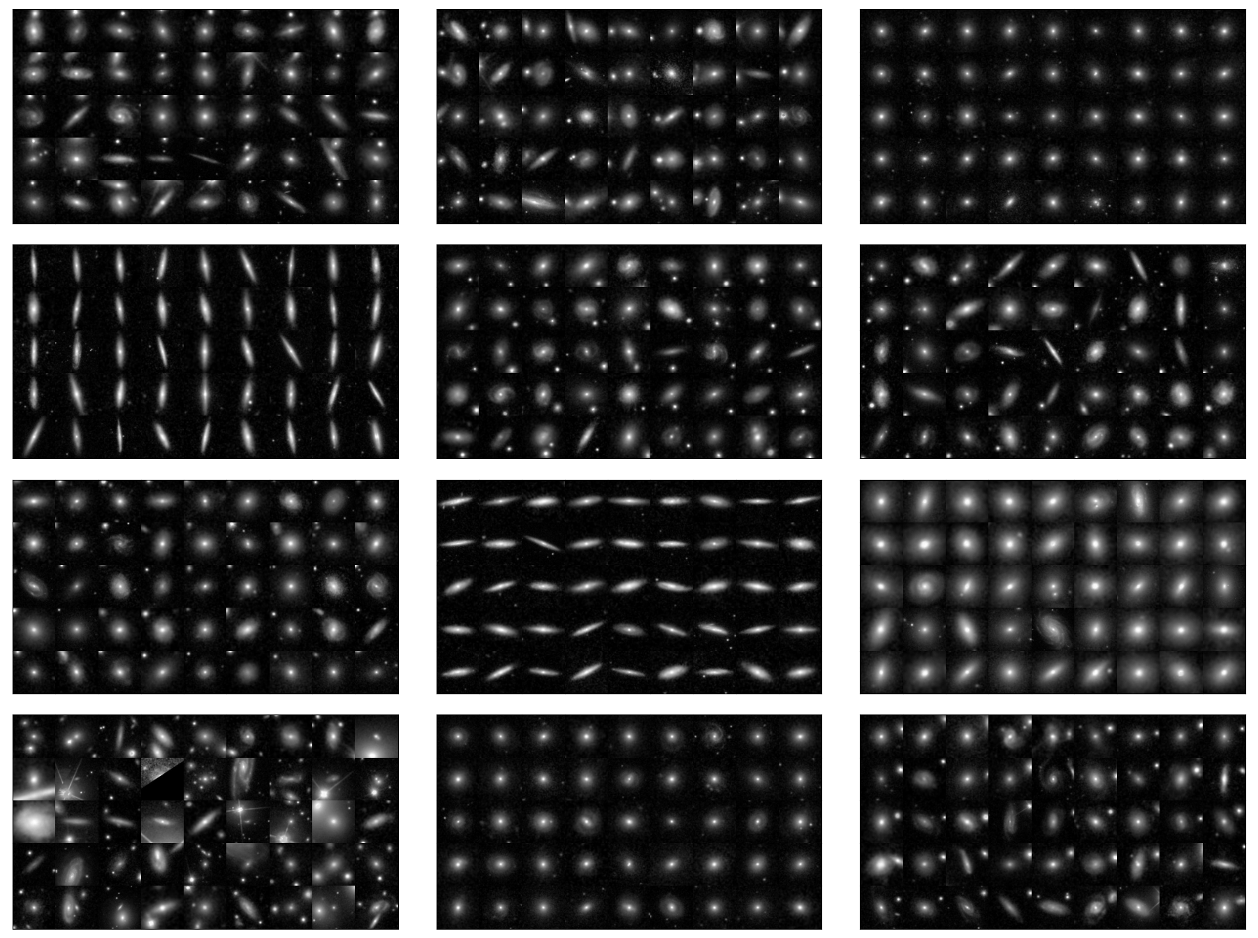
Standardisation
Ensuring all images are the same size—convolutional neural networks need images to have the same height and width
Creating limits of the scales and orientations of objects in the images—based on what you expect the network might see
eg: In images of galaxies, size is very important—and it depends on both physical size AND distance.

Slide 12
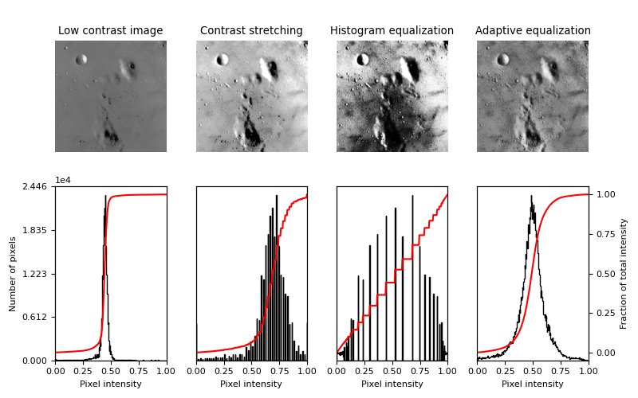
Standardisation
Ensuring all images are the same size—convolutional neural networks need images to have the same height and width
Creating limits of the scales and orientations of objects in the images—based on what you expect the network might see
Adjusting image contrast to enhance certain features
https://scikit-image.org/docs/stable/auto_examples/color_exposure/plot_equalize.html#sphx-glr-auto-examples-color-exposure-plot-equalize-py

Slide 13
Image Augmentation
Performing transformations to a dataset of images to improve the quality of training
Different from preprocessing—augmentation happens during the training process, usually using random transformations

Slide 14
Image Augmentation
Goal is to tackle underfitting and overfitting by artificially creating more data to train the network

Slide 15
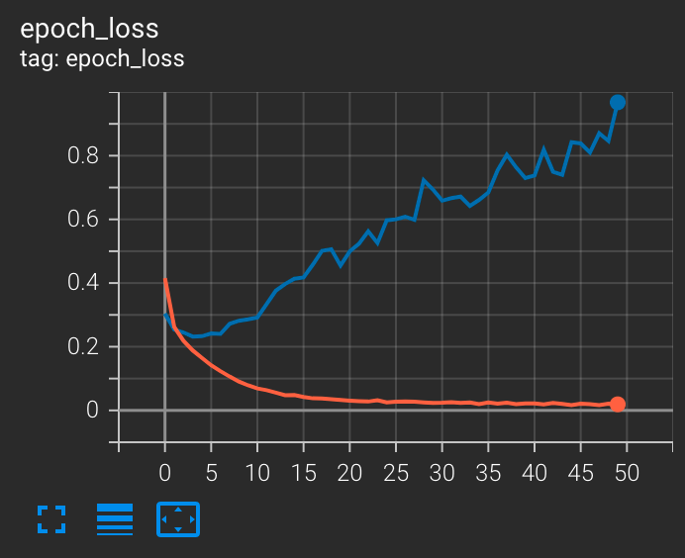
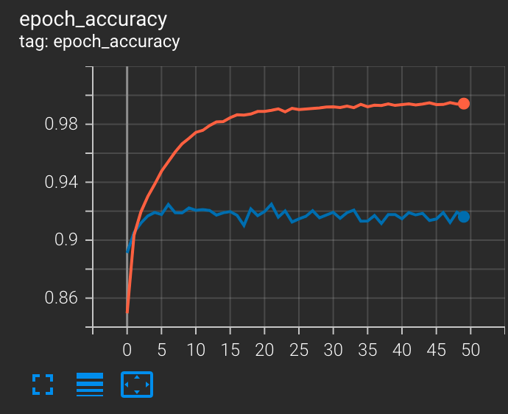
Image Augmentation - Overfitting
Overfitting is when the network can’t generalise to new data

Slide 16
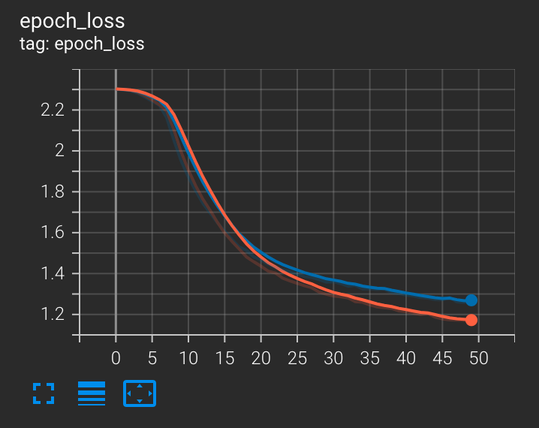
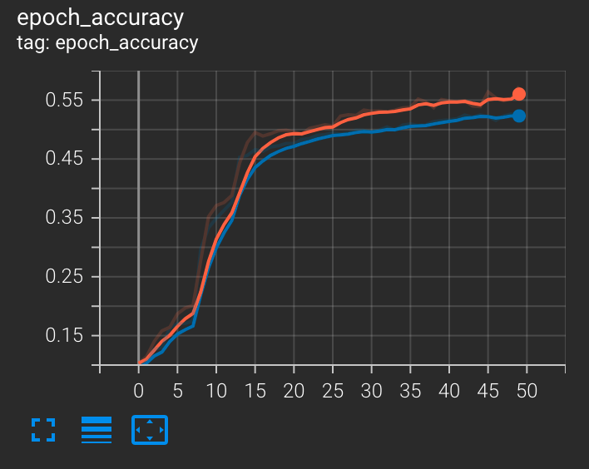
Image Augmentation - Underfitting
Underfitting occurs when the network can’t model the training data or testing data

Slide 17
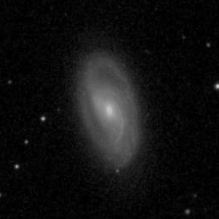
Image augmentation examples

Slide 18
Image augmentation examples Vertical Flip

Slide 19
Image augmentation examples Horizontal Flip

Slide 20
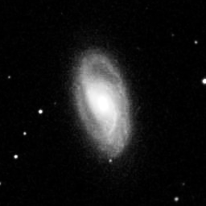
Image augmentation examples Adjust Contrast/Brightness

Slide 21
Image augmentation examples Zoom

Slide 22
Random Augmentations Increase Sample Size
Even just using flips, you can increase the number of “images” the network sees during training 4x:
Original image, H flip, V flip, H+V flip
But augmentations must be representative of the dataset—you generally shouldn’t vertical flip pictures of faces

Slide 23
TensorFlow Datasets
An API for building Input Pipelines

Slide 24
The tf.data API
TensorFlow introduces the tf.data API as a way to build input pipelines from simple, reusable pieces.
A pipeline could include: Loading images from memory, applying augmentations, shuffling the order, and batching the images with labels.

Slide 25
TensorFlow Datasets
The tf.data.Dataset object represents an abstract sequence of elements—where each element consists of multiple components
For example, a single element could be a training sample, consisting of an image and its label.

Slide 26
Creating Datasets
Datasets can be created from a data source, either stored in the RAM or in one or more files.
Data transformations create a dataset from one or more tf.data.Dataset objects.

Slide 27
Chaining Transformations
One a dataset has been created from a source, it can be transformed into a new dataset with chained method calls.
For example, you can apply per-element transformations like Dataset.map, or multi-element transformations such as Dataset.batch.

Slide 28
Python Iterable
A Dataset is a python iterable, which means it can be consumed in a for loop:
for elem in dataset:
print(elem.numpy())
Or by creating a Python Iterator:
it = iter(dataset) next(it).numpy()

Slide 29
Data Sources – Tensors, Arrays, Lists…
Data in the memory can be consumed with the from_tensor_slices method:
images = load_data(not a real function)
dataset = tf.data.Dataset.from_tensor_slices((images))

Slide 30
Data Sources – Tensors, Arrays, Lists…
from_tensor_slices consumes data along the first axis—individual elements are drawn from that axis:
tf.data.Dataset.from_tensor_slices( (tf.random.uniform([4, 100])))
>>> TensorSpec(shape=(100,), dtype=tf.int32, name=None)

Slide 31
Data Sources - Files
Images, for example, can be loaded from storage with a dataset. As loading the image is part of the dataset, images only exist in memory when they are used.
filepath = “/path/to/files/”
list_ds = tf.data.Dataset.list_files(filepath)

Slide 32
Batched Datasets
Datasets can be batched using the Dataset.batch() transformation. It stacks n elements into a single element of the new Dataset.

Slide 33
Training Workflows
Datasets can be repeated over multiple epochs with the Dataset.repeat() method.
Dataset.shuffle() randomly selects the next element from a fixed-size buffer.
We can preprocess and augment data using functions and Dataset.map().

Slide 34
Using tf.data with keras
In tf.keras, we can consume Datasets with the built-in .fit, .predict and .evaluate methods.
A Dataset that returns a batch of (images, labels) is used in place of (x=x_train, y=y_train).

Slide 35
Live Demo – tf.Data

Slide 36
Review
Data Pre-processing takes place before training, and is used to prepare the data by ensuring it is clean of unwanted anomalies, has standardised features, and is a uniform shape
Image Augmentation can be used during training to manipulate training images—such as by flipping or rotating—to artificially increase sample size

Slide 37
Questions???

